Slide 1
DS106 Capstone Project: Loan Default Prediction
Student name: Chow Hooi Koon
https://github.com/HelenChow22/loan-default-prediction

Slide 2
Dataset:
This is a bank dataset.
https://www.kaggle.com/c/credit-default-prediction-ai-big-data/data?select=train.csv

Slide 3
Table of Contents · Problem Statement · Question · Dataset Description · Read and understand Data · Data Cleaning · Exploratory Data Analysis · Model Building · Conclusion

Slide 4
Problem Statement Borrowers apply for loans for various reason. Individuals may apply for loans to buy a house, pay for a purchase etc. Organizations might take a loan to grow their business. But not everybody able to repay the loan because of somebody might experience financial distress. We have to predict who will default loan. The goal of this project is using Machine Learning to predict the probability that somebody will default loan. So that the bank could predict and try to reduce the probability of loan default, so that creditor/bank able to manage the lost.

Slide 5
Question: 1) What is the relationship between Home Ownership and Credit Default? 2) How the loan purposes affect the Credit Default? 3) Does Years in current job will affect the Credit Score in loan of Term? 4) How is the relationship among Years of Credit history, Annual Income and Credit Default?

Slide 6
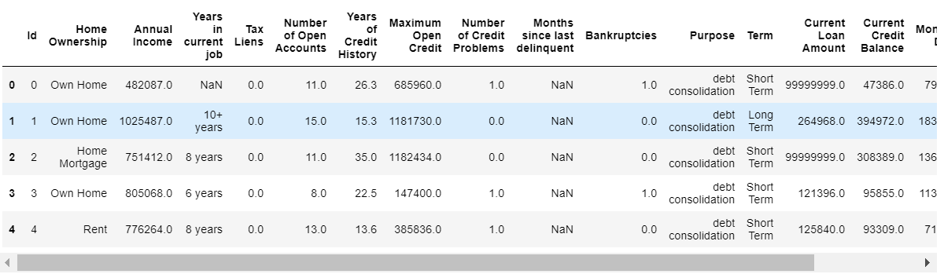
Sample dataset:
Total: 7500 rows x 18 features

Slide 7
Dataset Description:
1) Id: The number to identification a customer. 2) Home Ownership: The status of owning a house, e.g. own home, rent, home mortgage. 3) Annual Income: The total income that you earn over one year. (Disclaimer: this dataset did not declare that the annual income is before or after tax.) 4) Years in current job: The total years that you are working in current job. 5) Tax Liens: A legal claim against the assets of an individual or business that fails to pay taxes owed to the government. 6) Number of Open Accounts: How many accounts is reported open. 7) Years of Credit History: The record of your ability to repay debts and demonstrated responsibility in repaying them. 8) Maximum Open Credit: An open credit is a financial arrangement between a lender and a borrower that allows the latter to access credit repeatedly up to a specific maximum limit.

Slide 8
9) Number of Credit Problems: The borrower cannot or is unwilling to repay according to the original loan agreement. It is also referred to as a nonperforming asset. 10) Months since last delinquent: How many months that you are behind on payments. Once you are delinquent for a certain period, your lender will declare the loan to be in default. The entire loan balance will become due at the time. 11) Bankruptcies: A legal proceeding involving a person or business that is unable to repay their outstanding debts. 12) Purpose: The reason of a borrower to apply a loan. 13) Term: The period to repay the loan. E.g., short term or long term. 14) Current Loan Amount: The amount the borrower promises to repay, as set forth in the loan contract. 15) Current credit balance: A credit balance on your billing statement is an amount that the card issuer/bank owes you. 16) Monthly Debt: Recurring monthly payments, such as credit card payments, loan payment, etc. 17) Credit Score: Is a number between 300-850 that depicts a consumer’s creditworthiness. 18) Credit Default: The failure to repay a debt, including interest or principal, on a loan or security.

Slide 9
Steps:
Read and Understand Data.
Data Cleaning.
Exploratory Data Analysis
Model Building
a) KNeighborClassifier
b) RandomForest Classifier
c) LogisticRegression
d) Gaussian Naïve Bayes

Slide 10
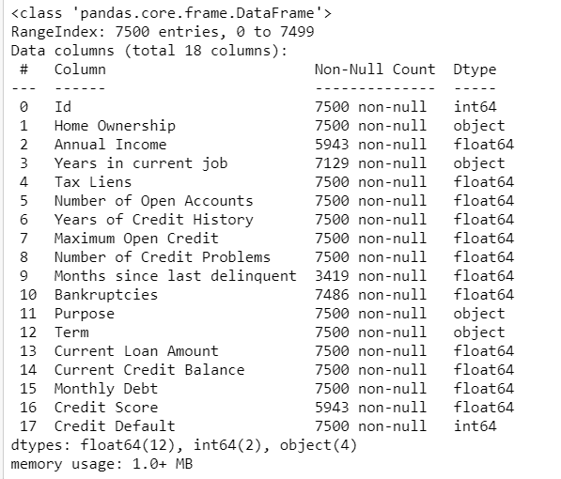
Steps 1: Read and Understand Data
* Shows all the elements.
* Null value:
- Annual Income
- Years in current job
- Months since last delinquent
- Bankruptcies
- Credit Score

Slide 11
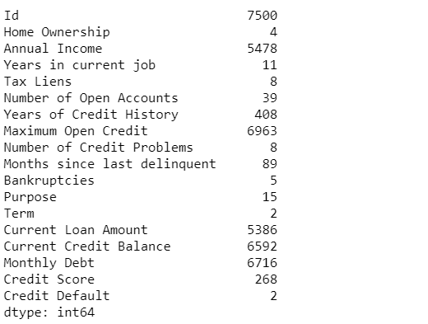
Steps 1: Read and Understand Data
* Check unique of all the elements.

Slide 12
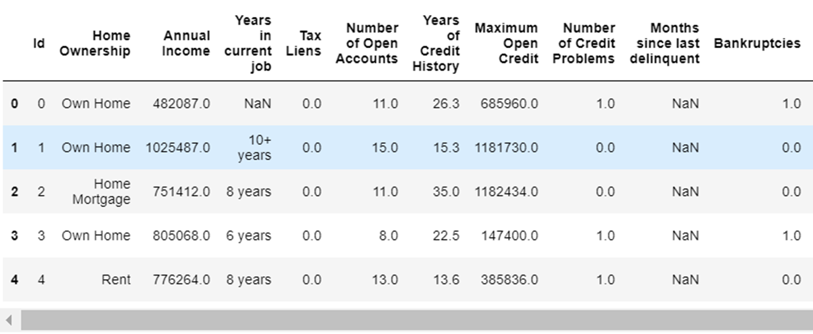
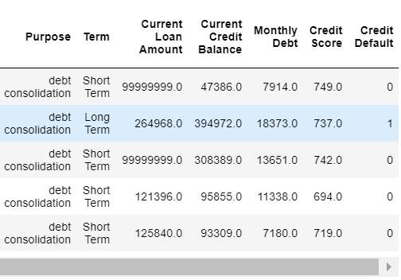
Steps 2: Data Cleaning
1) Change elements in column 'Current Loan Amount' of more than $10,000,000 (>$10m) to nan value because I found they are not realistic with the 'Annual Income' and 'Monthly Debt Amount'. Replace nan value to mean. 2) Change all the 'Years in current job' to numeric and take away the string 'years' and plus '+' sign. Replace nan value to mean. 3) Convert 'Years in current job' and 'Annual Income' to numeric. 4) Replace nan value to mean for columns 'Credit Score', 'Annual Income', 'Bankruptcies'. 5) Fill nan value for the columns. 6) Drop column 'Id' because this is not necessary to be observe or study by ML.

Slide 13
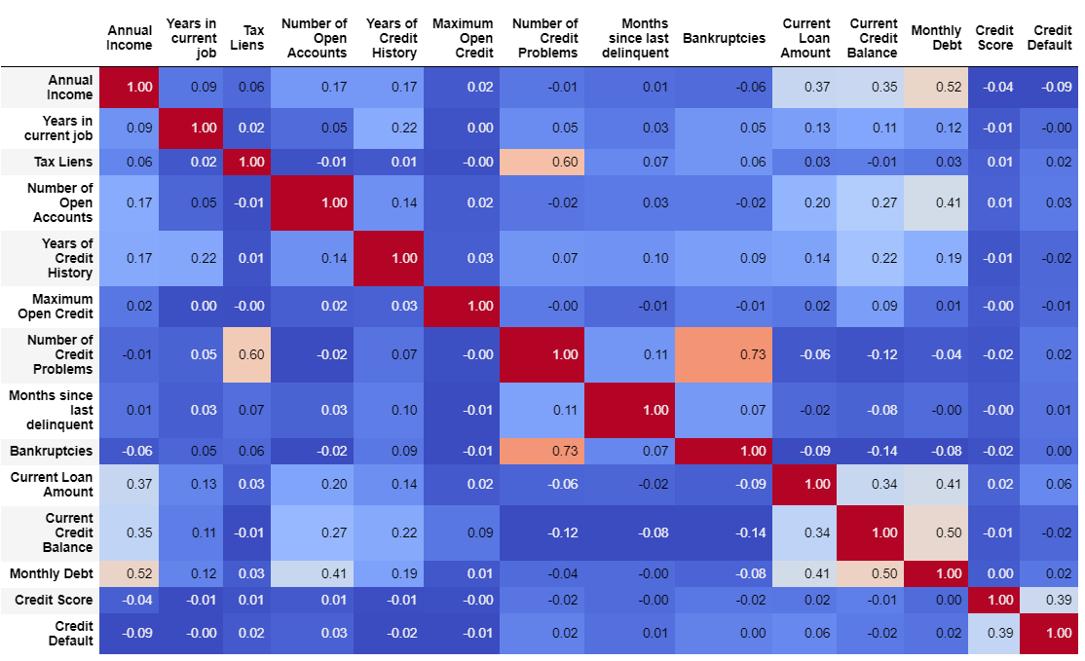
Steps 3: Data Visualization
Check the correlation-ship.
From the chart above it shows the low correlation-ship between the elements. Each element correlation-ship is lesser than 0.8. The elements of “Bankruptcies” and “Number of Credit Problems” is 0.73. Although it is closer to 0.8, but I will keep it to built machine learning models.

Slide 14
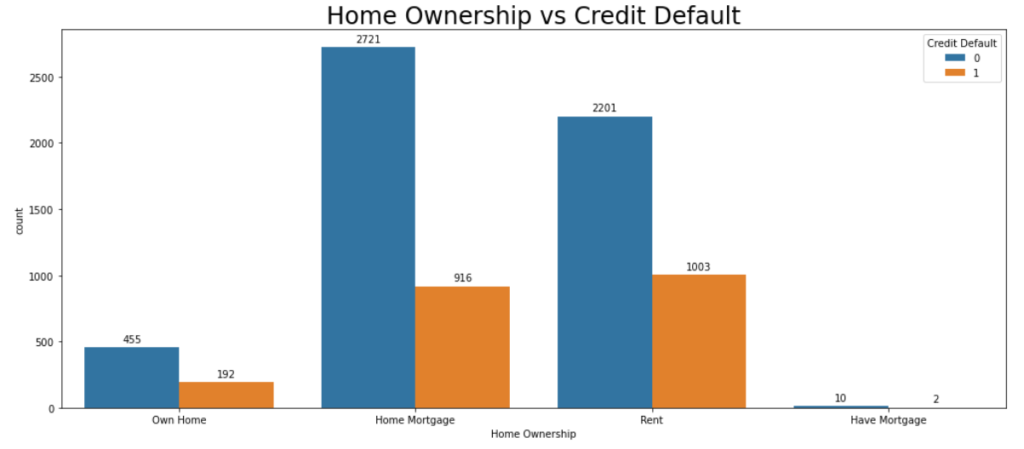
Steps 3: Exploratory Data Analysis
1) What is the relationship between Home Ownership and Credit Default?
Observation:
From the bar chart we can observe that 'Home Mortgage' and 'Rent' have high rate for credit default, whereby 'Rent' has the highest ratio as compared to other type of home ownership. Accommodation/lodging cost plays an important part of our living expenses. It is costly and cannot be ignore. Creditor/Bank can always send information to loan borrowers to advise them to check their financial status quarterly, provide information of refinance service, update loan’s term & conditions like any adjustable-rate loan etc. These to alert borrower to well manage their financial with enough updated information.

Slide 15
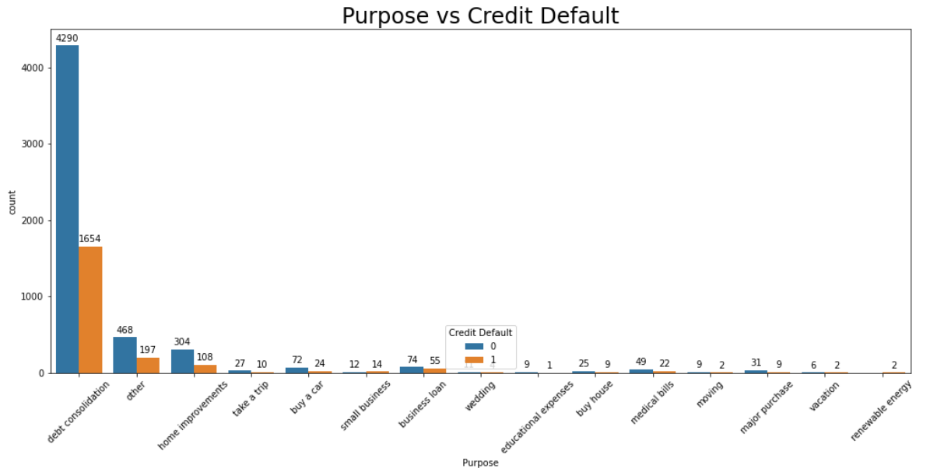
Steps 3: Exploratory Data Analysis
2) How the loan purpose affect the credit default?
Observation:
Debt consolidation has the highest rate of credit default. Debt consolidation means combining more that one debt obligation into a new loan with a favorable term structure such as lower interest rate structure, tenure/term etc. Debt consolidation is used by consumers to pay off a small debt in one go by taking one big loan. By doing this they save on interest as well as the finance cost of the small loan owed by them. The borrower would now have to make one payment instead of making multiple payments to other creditors. In another word, this group of borrowers spent a lot for different purposes. Creditor must monitor closely for this group of borrowers, and relook into the debt consolidation plan term & conditions and charges.

Slide 16
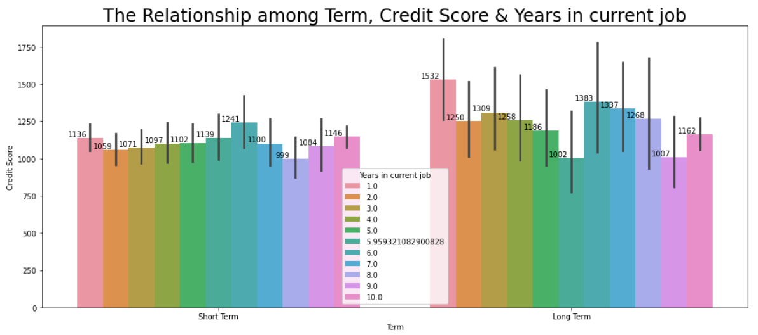
Steps 3: Exploratory Data Analysis
3) Does Years in current job will affect Credit Score in Loan Term?
Observation:
1 years & 6 years in current job have the better credit score in both short term and long-term loan period. This is maybe because of those 1 year in current job are fresh graduated, they yet to have affordability to apply loan. Those 6 years in current job, their status are more stable in terms of income and commitment. I would recommend the creditor/bank to offer more products which suits these 2 groups of people to increase the chance of profitability.

Slide 17
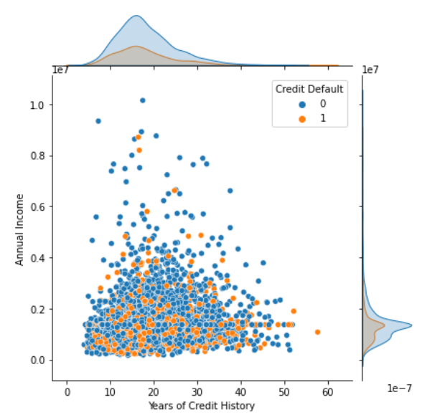
Steps 3: Exploratory Data Analysis
4) How is the relationship among Years of Credit History, Annual Income and Credit Default?
Observation:
The graph shows that people in 10 to 20 years of credit history and who have estimated annual income between 0 to 2 million, there got higher amount of loan default. The reasons of default loan during this period maybe because of various things that happened in life. Example marriage, buy house, travel, children education fee, parent & children medical fee, increase standard of living etc. All these will affect the financial activities. I would suggest to build a special team to assist this targeted group of people to give professional way to rearrange their financial structure.

Slide 18
Steps 4: Machine Learning
Data preparation for machine learning.
I found that there are many outliers. But I will only replace outlier with quantile of the elements below instead of I drop the outlier. If I drop the outlier, I will not have good enough number of data to build the machine learning model.
Adjusted outlier: Annual Income, Current Loan Amount, Current Credit Balance, Monthly Debt, Credit Score.
Check imbalance dataset, prepare balance dataset.

Slide 19
Steps 4: Machine Learning
Machine Learning
a) KNeighborClassifier
b) RandomForest Classifier
c) LogisticRegression
d) Gaussian Naïve Bayes

Slide 20
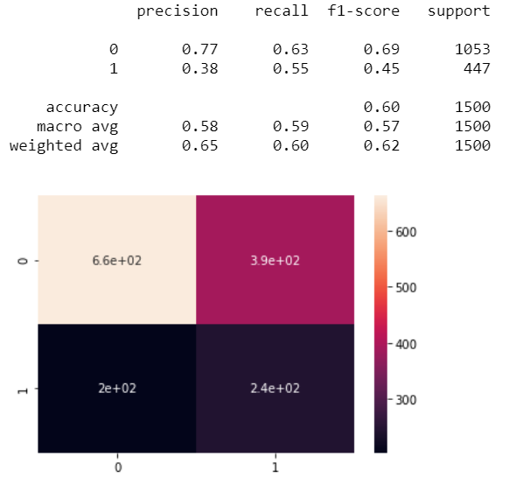
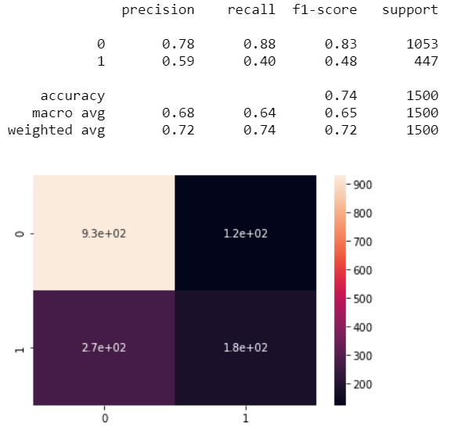
Steps 4: Machine Learning
KNeighborClassifier
RandomForestClaccifier

Slide 21
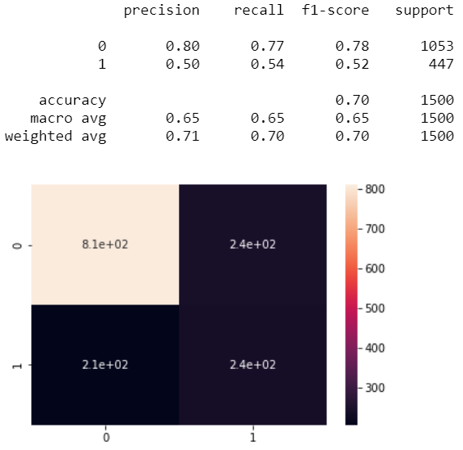
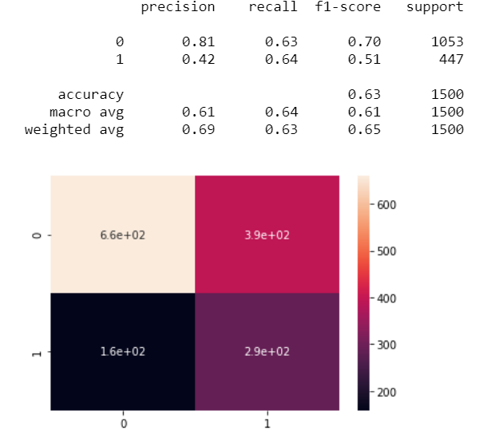
Steps 4: Machine Learning
LogisticRegression
Gaussian Naïve Bayes

Slide 22
Steps 4: Machine Learning
After testing on the four models, I found out that Random Forest Classifier provides a better prediction in terms of the f1 score & accuracy, hence I will use random forest for hyperparameter tuning to find out the best model for this prediction.

Slide 23
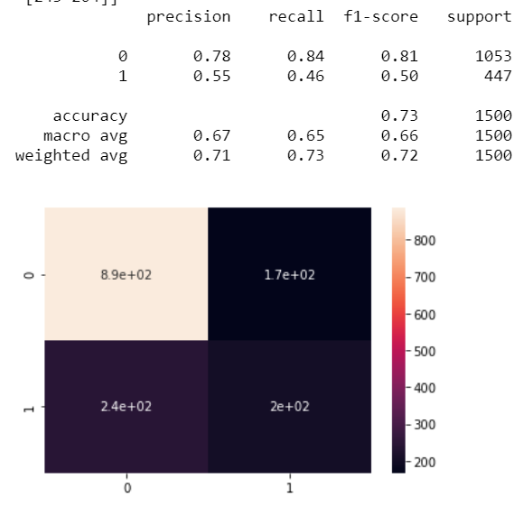
Hyperparameter Tuning
RandomForestClassifier
Summary:
Since we are predicting loan default. After hyperparameter tuning, the Random Forest Classifier performs better in predicting loan default (1), which f1 score increased together with micro average as compared to the previous result.

Slide 24
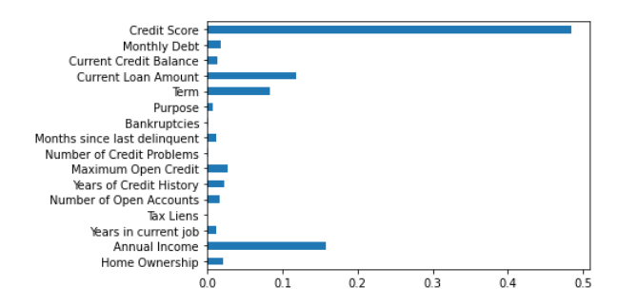
Features Importance
Conclusion:
From the graph of featured importance for the training, I found that the most important is the Credit Score of the borrowers, follow by Annual Income and Current Loan Amount. Not important for this training is Bankruptcies, Number of Credit Problems and Tax Liens. Creditor/bank must guard the loan approval closely accordingly credit score. This is to play a safe side that to reduce default loan rate.

Slide 25
Thank You
https://github.com/HelenChow22/loan-default-prediction

